Slide 1





A’Safeerul Jannah
Islamic Studies
for Kids
Age: 3-5 yrs
Jumeira Islamic Learning Centre

Slide 2
أ
Arabic
ب
1. Revision Of Alphabets
2. Tanween
3. Reading Words
4. Vocabularies
5. Simple Conversation
ث
ت

Slide 3

Quran
Revision, Hifdh and tafseer of Surahs:
*Al Masad
*An Nasr
*Al Asr
*Al Feel
*Al Maoon

Slide 4
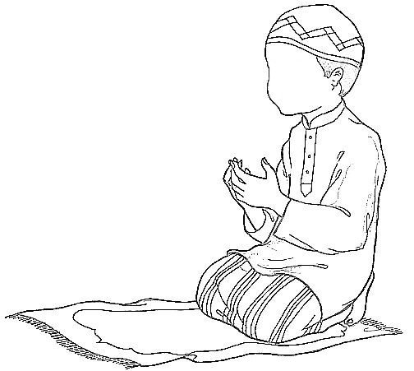
Islamic studies
Islamic manners
Duas
Pillars Of Islam
Practical Wudhu And Salah
Stories of Prophets

