Slide 1





A’Safeerul Jannah
Islamic Studies
for Kids
Age: 3-5 yrs
Jumeira Islamic Learning Centre

Slide 2
أ
Arabic
ب
1. Revision Of Alphabets
2. Introducing Tashkeel
3. Vocabularies
4. Simple Conversation
ث
ت

Slide 3

Quran
Revision, Hifdh and tafseer
of Surahs:
*Al Fatiha
*Al Masad
*An Nasr
*Al Kawthar

Slide 4
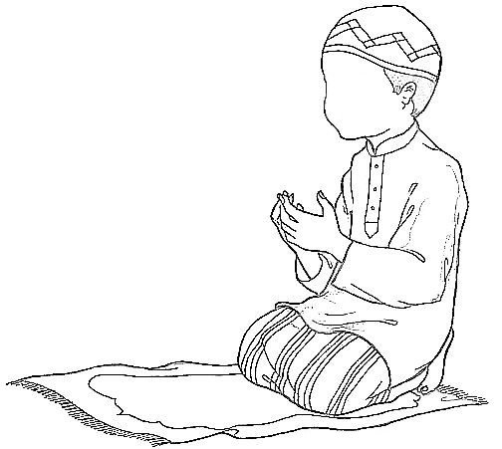
Islamic studies
Islamic manners
Duas
Pillars Of Islam
Stories of Prophets

